Slide 1
COVID-19 Data Analysis
Name : AFNAN A
AF ID : AF0368372
Guide Name : MANALI PATIL

Slide 2
ABSTRACT
This project looks at data about COVID-19, the disease caused by the coronavirus. We use computer programs to study this data and understand what's happening with the pandemic. We analyze things like how many people are getting sick, how many are dying, and how many are getting better. By looking at data from different countries, we can see patterns and differences in how the virus affects people. We use graphs and numbers to show these patterns, which can help governments and health experts make better decisions to fight the virus. This project aims to give clear information that can help us deal with the pandemic better.

Slide 3
Software Requirements:
Python:
Python is a programming language commonly used for data analysis and visualization. We will utilize Python for data manipulation, analysis, and visualization tasks.
Jupyter Notebook:
Jupyter Notebook is an interactive computing environment that allows for creating and sharing documents containing live code, equations, visualizations, and narrative text. It will be used for organizing and presenting the analysis in a structured manner.
Pandas:
Pandas is a powerful Python library for data manipulation and analysis. It provides data structures and functions to efficiently manipulate large datasets.
NumPy:
NumPy is a fundamental package for scientific computing in Python. It provides support for large, multi-dimensional arrays and matrices, along with a collection of mathematical functions to operate on these arrays.
Matplotlib:
Matplotlib is a plotting library for Python and NumPy. It enables the creation of static, animated, and interactive visualizations in Python. We will use Matplotlib to generate various types of plots and graphs to visualize the COVID-19 data.

Slide 4
Advantages of the Project
Easy Understanding:
This project helps us understand COVID-19 data easily. We can see how the virus is spreading, how it affects different places, and what trends we notice over time.
Helps Decision Making:
By looking at the data, we can make better decisions. This includes choices made by government leaders, doctors, and others involved in handling the pandemic.
Spreading Awareness:
We can use the findings from this project to tell people more about COVID-19. It helps them understand why it's important to take precautions and get vaccinated.
Using Resources Wisely:
The project helps us figure out where to send medical supplies and help. We can see which areas need more help because they have more cases.
Learning About the Virus:
Scientists can use this project to study the virus better. They can learn how it spreads and what factors make it worse.
Working Together:
This project lets different people share what they've learned. This helps everyone learn more about how to handle health emergencies like COVID-19.

Slide 5
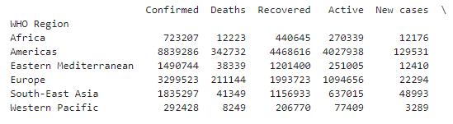
Regional Record Analysis

Slide 6
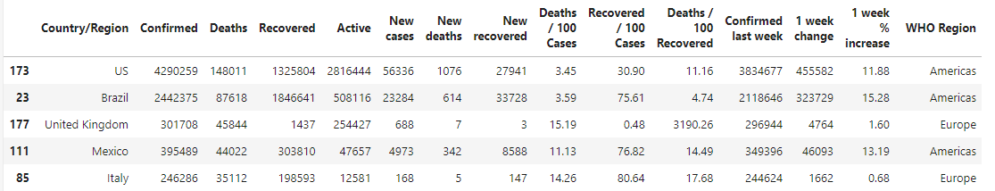
Countries Effected by Elevated Death Rates

Slide 7
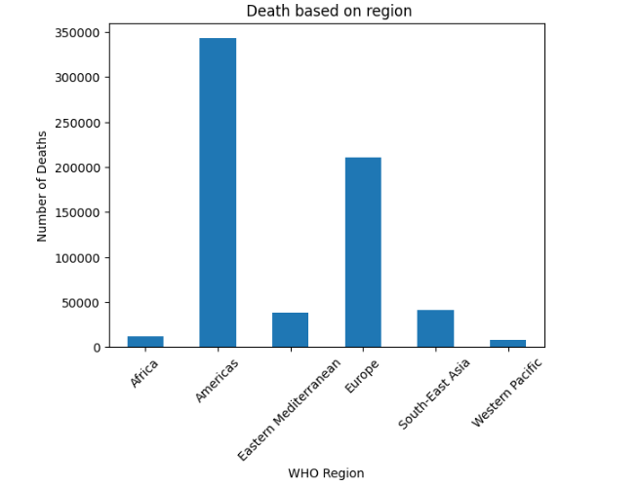
Regional Death Statistics

Slide 8
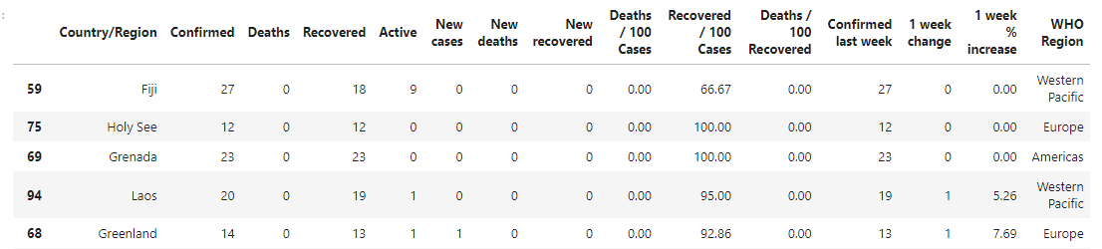
Countries With Lower Death

Slide 9
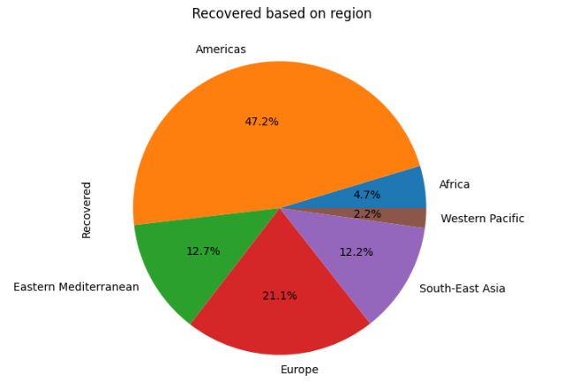
Regional Recover Statistics

Slide 10
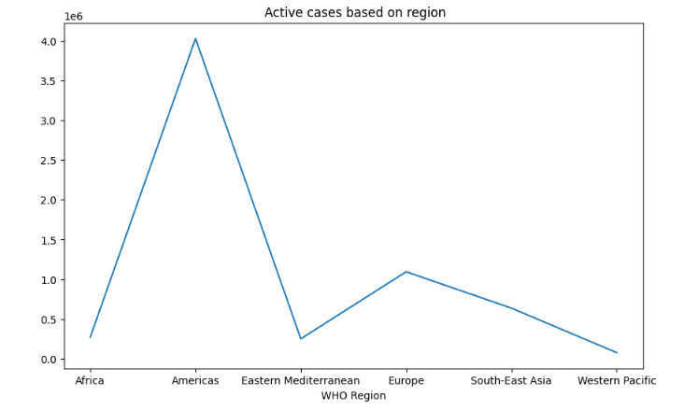
Active Infection Status

Slide 11
Future Enhancements
Predicting the Future:
We can make tools that guess what might happen with COVID-19, like how many people might get sick or recover.
Real-time Data Integration:
We can make sure our data is always up-to-date by adding new information as soon as it comes out. This means our analysis is always accurate
Geographic Analysis:
We can make maps that show where COVID-19 is spreading the most. This helps decide where to focus efforts to stop it.
Sentiment Analysis:
We can use tools to see what people are saying about COVID-19 on social media. This helps understand what people are worried about and if they have wrong information.
Collaborative Research:
We can work with doctors, scientists, and governments to get more information and help solve COVID-19 problems faster.

Slide 12
Conclusion:
The analysis of the COVID-19 dataset helps us understand how the virus has affected different
countries and regions. It shows us how many people have been infected, how many have died,
and how many have recovered. By studying this data, we can see the importance of taking action
quickly to stop the virus from spreading further. It also reminds us that working together globally is
crucial in fighting such health crises. Looking ahead, we need to keep monitoring the data to make
smart decisions and policies. Despite the challenges we face, there is hope as communities around
the world continue to adapt and respond to the pandemic.

Slide 13
Thank you for your attention and interest in exploring the insights derived from the COVID-19 dataset. Your engagement in understanding the data and its implications is crucial in combating this global health crisis. Let's continue to work together to analyze and utilize data effectively for the improvement of public health and safety. Once again, thank you
Thank You

